Slide 1
YOU GOT THIS!
(Starting the journey of counseling w/ young people from the Bible)
February 8th, 2025

Slide 2
What we hope for Today….
What do you believe?
What does it take?
The Guide
The Journey
Journey of Lament…
Other Places to “Start the Journey”…
EVERYTHING We do today can be used in daily interactions with others!
But we also want you to think about this question: “Do I want learn & do more?”

Slide 3
What do you believe?
(Counseling in our culture)

Slide 4
“Answers” always come from one of two sources
Jesus Said…
Jesus Said…
Pilate therefore said to Him, “Are You a king then?” Jesus answered, “You say rightly that I am a king. For this cause I was born, and for this cause I have come into the world, that I should bear witness to the truth. Everyone who is of the truth hears My voice.” (John 18:37)
You are of your father the devil, and the desires of your father you want to do. He was a murderer from the beginning, and does not stand in the truth, because there is no truth in him. When he speaks a lie, he speaks from his own resources, for he is a liar and the father of it. (John 8:44)
What is YOUR Source?

Slide 5
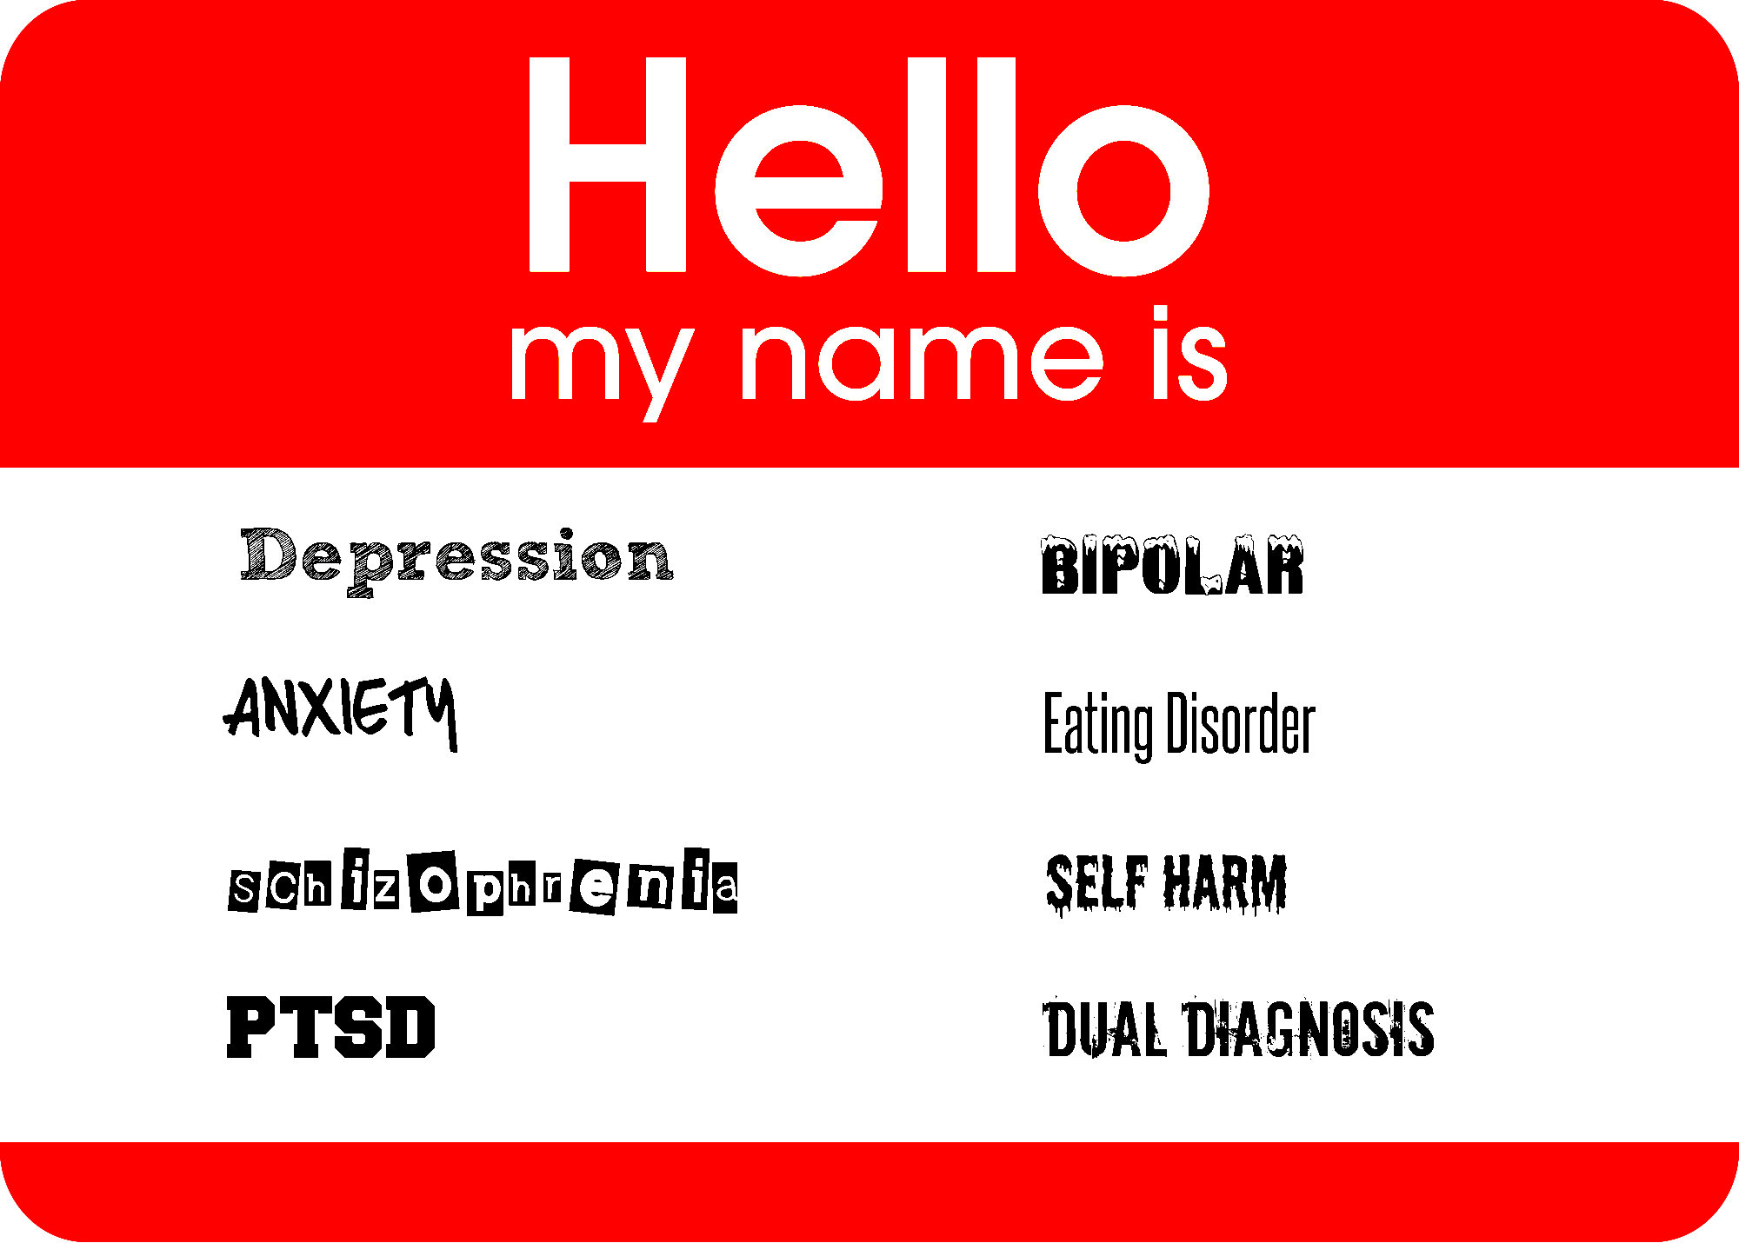
Do you believe Christians can help?
Question: When we as Christians talk of love, joy, peace, forgiveness, strength, or grace through our great Savior Jesus Christ,
- Mental Health Conversation or Not?

Slide 6
Which path will you chose?
And Elijah came to all the people, and said, “How long will you falter between two opinions? If the Lord is God, follow Him; but if Baal, follow him.”
I Kings 18:21 (NKJV)
Isaiah 28:15 (NKJV)
2 Corinthians 5:14-15, 17 (NKJV)
Because you have said,
“We have made a covenant with death…
When the overflowing scourge passes through, It will not come to us,
For we have made lies our refuge,
And under falsehood
we have hidden ourselves.”
For the love of Christ compels us,
because we judge thus: that if One died for all, then all died; and He died for all,
that those who live should live no longer for themselves, but for Him who died for them…
Therefore, if anyone is in Christ, he is a new creation; old things have passed away; behold, all things have become new.

Slide 7
So, Question for you…..
When your __________ comes to you
Where will send them for help?
Are you confident in it?
Do you go to there for help?
“And you shall know the truth, and the truth shall make you free.” – John 8:32 (NKJV)

Slide 9
What does it Take?

Slide 10
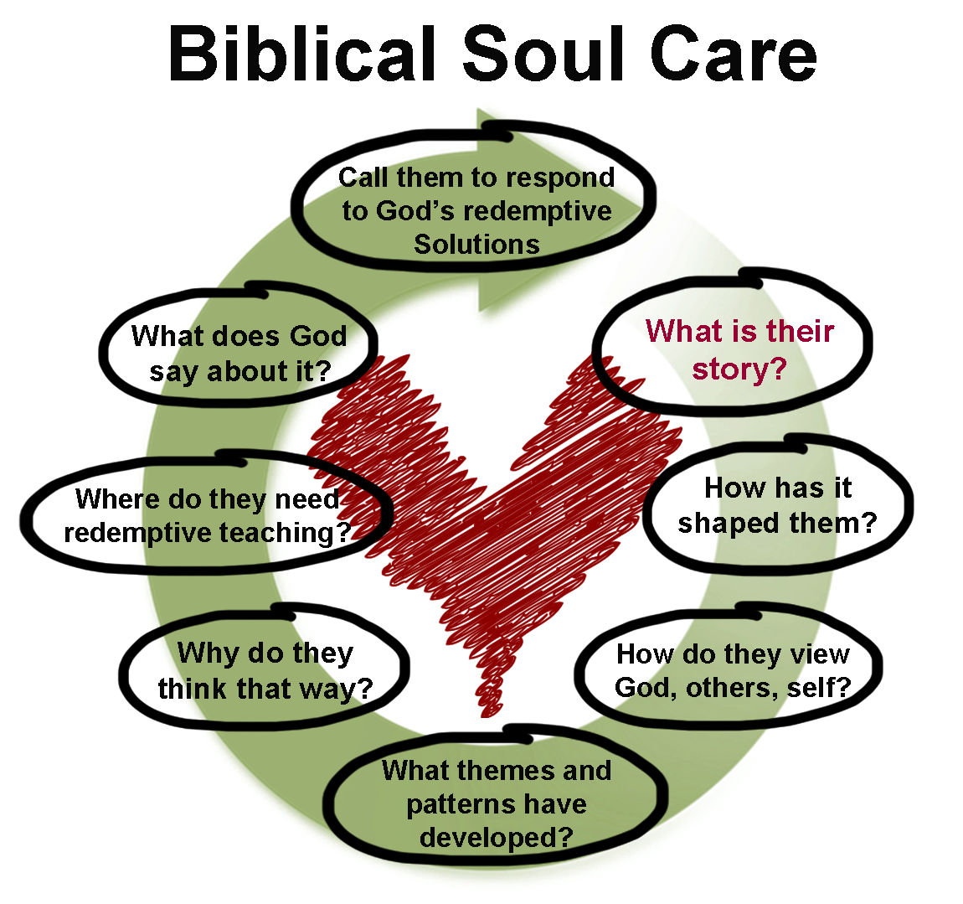
What Does it Take…
Romans 15: 1-6
Maturing Christian (vs. 1-3)
Bear with the _____________ of the ___________
NOT out to ____________ Ourselves
Focus is _______________ for _________ good
Resting in God’s Word (vs. 4)
_______ Learning
________ _______________ and ________________
________ have __________
Doing it For ____ ____ ______ ___ ____ _____ ______ _____ (vs. 5,6)
scruples
weak
please
others
their
The Person of GOD
Empower with the Spirt of GOD
Equipped with the WORD of GOD
Can help others!
OUR
YOUR
patience
comfort
YOU
hope
God and Father of our Lord Jesus Christ

Slide 11
Walking the Journey
Guiding
What does God want?
The storms of life are real..
What “is” True in the storms?
Sustaining
Healing
Sin Damages relationships
This is exampled by Paul in
I Thessalonians, Chapter 2
Reconciling
From the work of Kellemen, Robert W.. Gospel Conversations: How to Care Like Christ (Equipping Biblical Counselors)

Slide 13
Counselor Journey – Lament Study…
(Sustaining to Healing) / (Reconciling to Guiding)

Slide 14
Biblical Lament: A gift and a tool
In Lamentations and Psalms, God gives us a pattern for our grief.
Largest category of psalms
(Ex: Ps 6, 10, 13, 17, 22, 25, 42-43, 130…)
Search “Psalms of Lament”
Lament pattern = 1) Turn to God; 2) bring your
questions and complaints; 3) ask boldly;
4) remember and choose to trust
(See the book Dark Clouds, Deep Mercy)

Slide 15
Biblical Lament: Example from Psalm 13
How long, O Lord? Will you forget me forever? How long will you hide your face from me? ² How long must I take counsel in my soul and have sorrow in my heart all the day? How long shall my enemy be exalted over me?
³ Consider and answer me, O Lord my God; light up my eyes, lest I sleep the sleep of death, ⁴ lest my enemy say, “I have prevailed over him,” lest my foes rejoice because I am shaken.
⁵ But I have trusted in your steadfast love; my heart shall rejoice in your salvation. ⁶ I will sing to the Lord, because he has dealt bountifully with me.
Psalm 13—
1) Turn to God
2) Bring your questions
and complaints
3) Ask boldly
4) Remember and
choose to trust

Slide 16
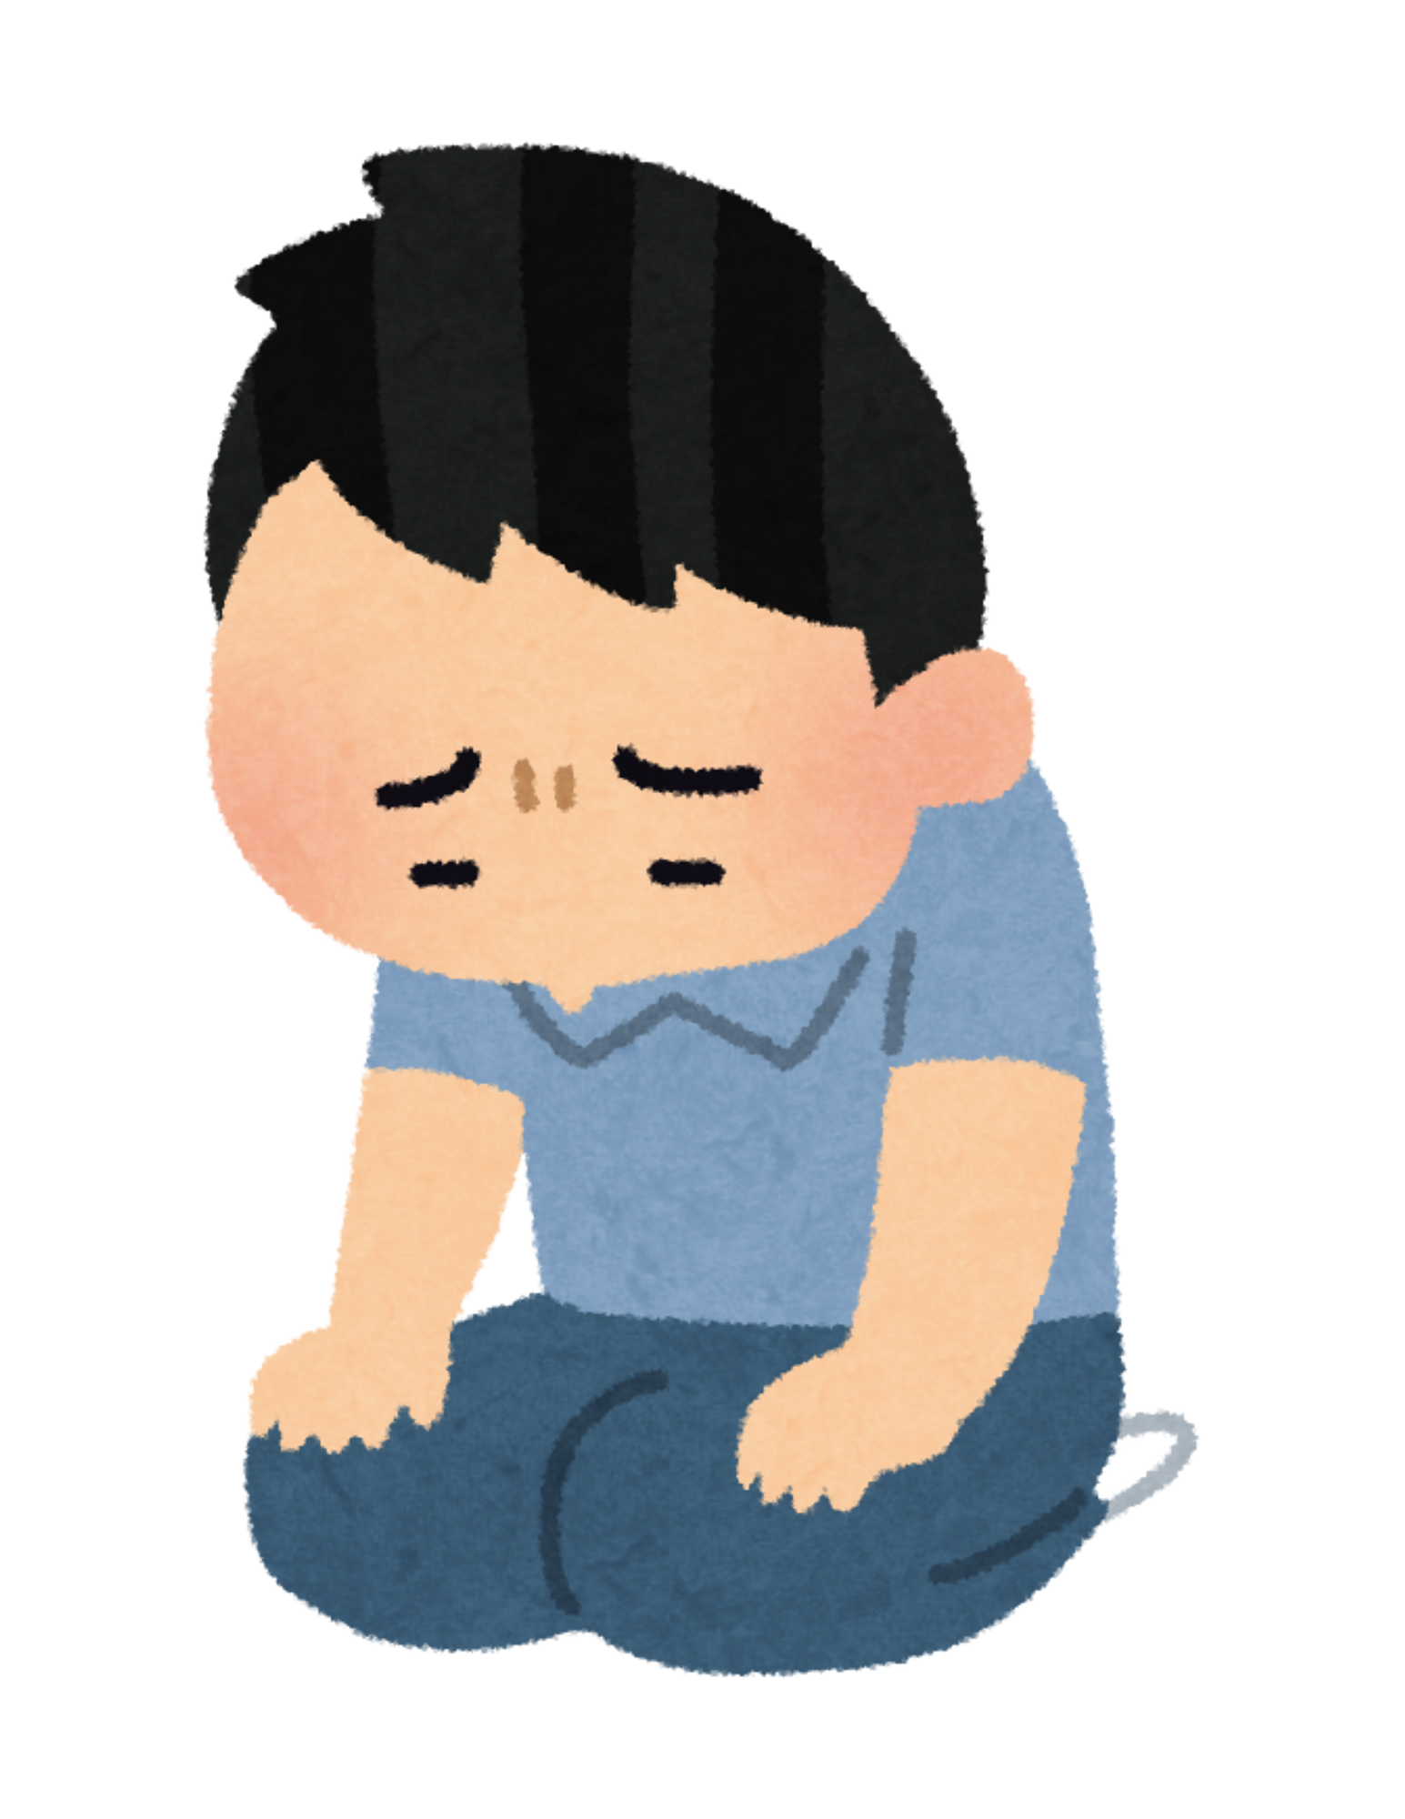
Biblical Lament: How to use it
--Grieve with the counselee; teach them to lament
Biblically
--Pray for them in that pattern
--Practice lamenting by praying together
--Assign them to write their own prayer
of lament

Slide 17
Other Starting Spots in Scripture to
Walk the Journey…

Slide 18
General Encouragement (Matt 11:28-30)
“Come to Me, all you who labor and are heavy laden, and I will give you rest. Take My yoke upon you and learn from Me, for I am gentle and lowly in heart, and you will find rest for your souls. For My yoke is easy and My burden is light.”
Question: What do you see?
Notes:
“TELL HER”

Slide 19
General Encouragement (Matt 11:28-30)
“Come to Me, all you who labor and are heavy laden, and I will give you rest. Take My yoke upon you and learn from Me, for I am gentle and lowly in heart, and you will find rest for your souls. For My yoke is easy and My burden is light.”
Question: What do you see?
Who is the “target” audience?
What is the promise?
What is the “key” for the promise?
What are phrases that don’t seem to belong?
Notes:
“TELL HER”

Slide 20
Anxious (Psalm 23)
PSALM 23 | My Part | God’s Part
The Lord is my shepherd; I shall not want.
He makes me to lie down in green pastures; He leads me beside the still waters.
He restores my soul; He leads me in the paths of righteousness For His name’s sake.
Yea, though I walk through the valley of the shadow of death, I will fear no evil; For You are with me; Your rod and Your staff, they comfort me
You prepare a table before me in the presence of my enemies; You anoint my head with oil; My cup runs over.
Surely goodness and mercy shall follow me All the days of my life; And I will dwell in the house of the Lord Forever.
Notes:
“TELL HER”

Slide 21
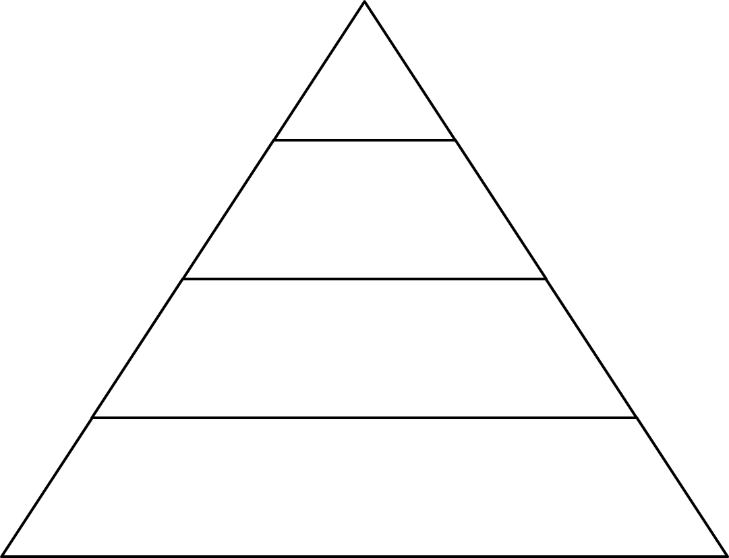
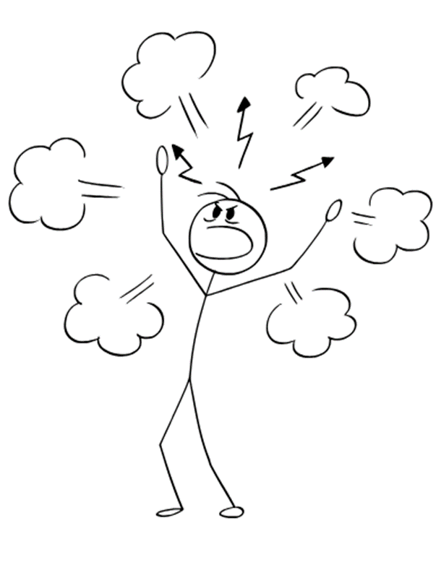
Angry (Book of Jonah)
Chapter 4
Chapter 3
Chapter 2
Chapter 1
Notes:
“TELL HER”

Slide 22
“Rough” Life (2 Kings 5)
Person # 1_______________
Person #2________________
What is their life like?
What is their life like?
FINAL Question: Which Person was more convinced in the power of God?
Notes:
“TELL HER”

Slide 23
Thank you for Listening (And not throwing tomatoes…)

