Slide 1
Gospel Centered Leadership
Presenter: Ben Burrow

Slide 2
Question: “Why is the Gospel important when building Christian community?”

Slide 3
A community must have a foundation. Without the proper foundation people may not understand the goal of the mission.

Slide 4
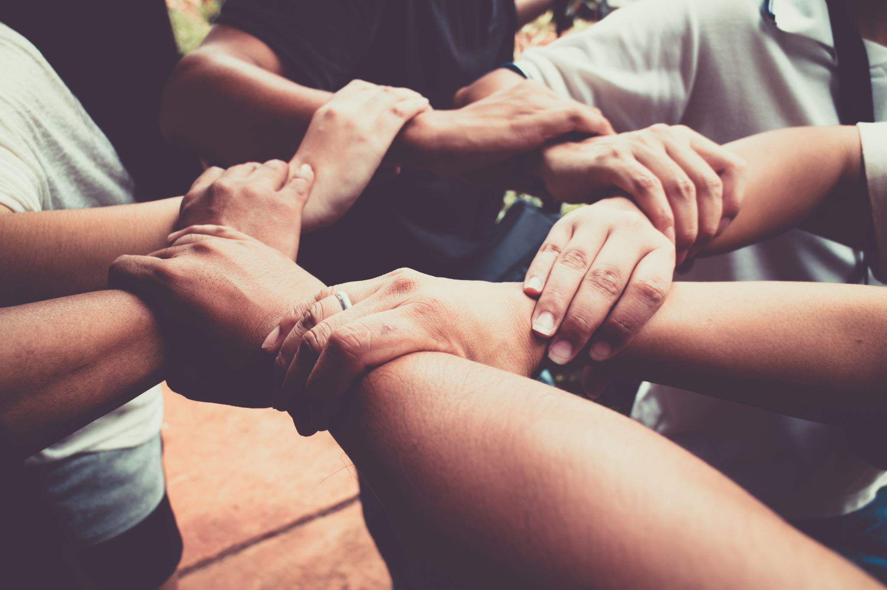
To create a Gospel Centered community we must keep the mission the focus while we are on mission.

Slide 5
As Christian leaders keeping the Gospel at the center of our mission glorifies God and fulfills the great commission. Matthew 28:19-20

Slide 6
Ultimately serving our community should have at its core the mission of sharing the good news of Jesus with others.
People are searching for community that gives them purpose. Jesus and the message of the gospel provides people with true purpose and right intention.

Slide 7
To serve and build a community rooted in Christ, those who lead must be on the same page about their beliefs.

Slide 8
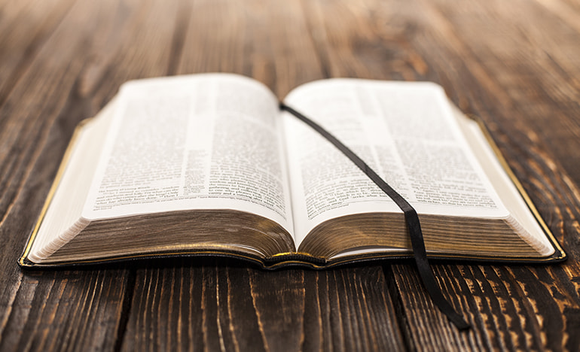
We must make sure the biblical Gospel is clearly known by those who we are on mission with.

Slide 9
Galatians 1:8-9 ⁸ But even if we or an angel from heaven should preach a gospel other than the one we preached to you, let them be under God’s curse! ⁹ As we have already said, so now I say again: If anybody is preaching to you a gospel other than what you accepted, let them be under God’s curse!
There is only 1
True Gospel

Slide 10
What are the key components of the Gospel

Slide 12
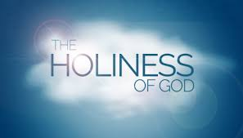
The Gospel begins by understanding the holiness of god.
God must be understood as HOLY. (1 Sam 2:2)
God must be understood as being set apart from the rest of creation.
God must be understood as being perfect. (Matthew 5:48)
God must be understood as absolute truth, unable to lie. (Titus 1:2)

Slide 13
Once we understand rightly who god is, then we can rightly understand who we are.
Because of the fall every human ever created (excluding Jesus) are by nature sinful. (Romans 3:23-24, 5:12)
We are not sinners because we sin, we sin because we are sinners.
Our sin nature SEPARATES us from God. NONE OF US ARE GOOD by God’s standard. Without God we are UNABLE to be with God because of our sin nature. We are COMPLETELY INCAPABLE to save ourselves and make ourselves holy and perfect as God is Holy and perfect. (Romans 3:10-12)
We are all or at one time were unable to turn from sin, humans are dead in our sins and in dire need of a Savior. (Ephesians 2:1-3)

Slide 14
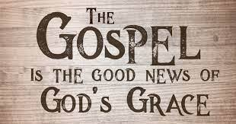
“But God shows his love for us in that while we were still sinners, Christ died for us” – ROMANS 5:8

Slide 15
The Gospel is the Good news about our messiah Jesus. BUT WHO Is JESUS?
Jesus is God. He is fully God and yet fully man. (Matt 10:40, John 4:25-26)
Jesus was born of a Virgin. Meaning he was not born with a sin nature like the rest of Humanity. (Isaiah 7:14, Heb 7:26)
Jesus came to earth and lived a perfect sinless life, a life we could not live. (1John 3:5)
Jesus went to the cross willingly as our substitute. (Heb 12:2)
Jesus died on the cross paying the debt for our sin. The debt that we could not pay ourselves. After 3 days Jesus then was brought back to life. (1Cor 15:3-8)
Jesus finished work on the cross and resurrection proves his perfect sacrifice was accepted and that now because of Christ ALONE our sin debt is paid in full. (Col 1:14)

Slide 16
We cannot assume all people who claim to be Christians know the gospel.

Slide 17
In 2022 Ligonier Ministries conducted a study called The State of Theology: What Evangelicals Believe. What they discovered from the study was A significant number of evangelicals surveyed (i.e., those identified as having evangelical beliefs) have a profound misunderstanding of the Gospel and the nature and character of God.

Slide 18
Only (66 percent) stated God is a perfect being and can not make a mistake. More than half (55 percent) agree that “everyone sins a little, but most people are good by nature.” Only (25 percent) say even the smallest sin deserves eternal damnation. Almost half (44 percent) say that Jesus was a great teacher, but he was not God. Only (47 percent) say the biblical accounts of the physical (bodily) resurrection of Jesus are completely accurate and that this event actually occurred. Only (42 percent) stated Jesus Christ death on the cross is the only sacrifice that could remove the penalty of my sin. Only (57 percent) believe God counts a person as righteous not because of one’s works but only because of one’s faith in Jesus Christ. (60 percent) said religious belief is a matter of personal opinion; it is not about objective truth. More than half (58 percent) believe that God accepts the worship of all religions, including Christianity, Judaism, and Islam.

Slide 19
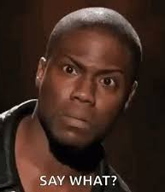
These Results show us that messages presented may have components of the Gospel, but ETERNALLY IMPORTANT truths are either being missed or left out completely.

Slide 20
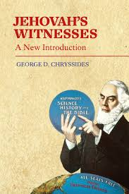
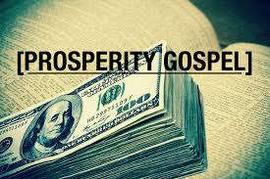
Sharing the true Biblical gospel is also important because a lot of false gospels are being shared.

Slide 21
Laying a foundation built on the Biblical Gospel matters.
God through the Biblical Gospel creates Christians that build His kingdom. (Acts 9:31)

Slide 22
The Gospel builds Gods kingdom. Christians make up Gods community.
God saves sinners through the gospel. (Romans 10:17 Romans 1:16)
Saved people desire to be in community with other believers.
The Biblical worldview gives proper explanation for good works and morality, which ultimately should be the motivation for serving and being in community. (Ephesians 2:10)

Slide 23
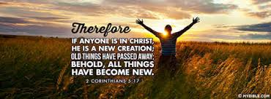
Through the Gospel message people are born again. The Gospel is the means by which God saves sinners. When we get saved the bible says we are now new creations. 2 Corinthians 5:17 .

Slide 24
As a result of being born again the holy spirit will produce fruit in a believer's life. (Gods good works) “we are created in Christ for good works” (Ephesians 2:10)

Slide 25
Good works are produced by believers who now work for Gods Glory.
A biblical worldview creates good works, serving and caring for others.
Moral goodness is ultimately founded on the biblical worldview. We serve others for the Glory of God, not for our own self worth.
Morality is a good thing.
Morality without Christ ultimately is about self.

Slide 26
The mission and the building of community is successful because God works through believers to accomplish His good works. God gives us right direction and right intention.

Slide 27
Why do you serve at Restoration Ranch?

Slide 28
Is your mission to Glorify God through serving others?
Or
Do you serve: “because it makes me feel good?”
With the objective to Glorify God through serving others consistent long-term community can be reached. By keeping right perspective on mission, we create a community that continues to grow and serve for the right reasons
“I want to Glorify God, I want others to see Christ in me and seek to do the same.” – Excellent, this should be part of the mission and a key component to build a community that serves with the right intentions of the heart. This understanding comes through those who believe the Gospel and put their hope, faith and trust in Jesus Christ.

Slide 29
Believers are Adopted into Gods family. By this true love can be understood and community can be built. John 13:34-35

Slide 30
When people Truly believe they are part of Gods family they can form true biblical community.
1 Cor 12:12-13a
“For just as the body is one and has many members, and all the members of the body, through many, are one body, so it is with Christ. For in one Spirit, we were all baptized into one body.”

Slide 32
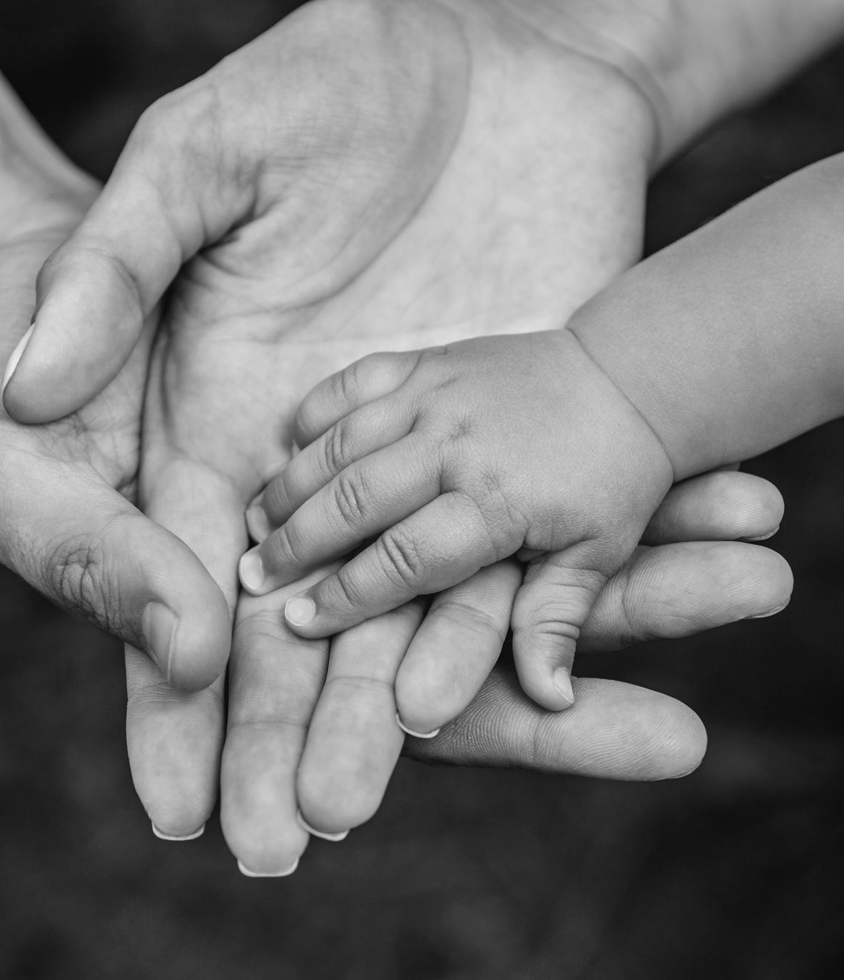
The biblical doctrine of adoption helps us to understand and experience real relationship with God and in turn His family.
GOD DELIGHTS IN HIS CHILDREN; God doesn’t simply tolerate us.
God wants to spend time with us in real relationship. GOD REALLY LOVES YOU.
Adoption rightly taught tells us we don’t have to shy away from God because of our past, God didn’t just save us and now doesn’t want anything to do with us. The idea that we were unmerited in receiving salvation is TRUE. However, justice has been served, the penalty has been paid by Jesus. We now can embrace a relationship with our Father who desires to know and be known by us.

Slide 33
Leading people through the gospel to form community rooted in the gospel, is the………

