Slide 1
Agenda for the Day / Intro
9:00 am-Introduction
9:30 am-Talk on Biblical counseling (You got this!)
11:00 am-Break time
11:30 am-Talk on the Gospel (Gospel Centered Leadership)
12:30 pm-Lunch
1:00 pm-Team Building challenge
2:00 pm- Talk on Next Gen (Raising up Student leaders)
2:50 pm- Break time
3:10 pm- Talk on Prayer (Principles of Prayer)
4:00 pm- Talk on the Practical (What a Season of Successful Serving looks like)
5:00 pm Dismissed

Slide 2
Leadership Training
Q1 2025

Slide 3
Doug Seest with Compel Ministries
You got this!
Starting the journey of counseling young people from the Bible

Slide 4
Break Time!!

Slide 5
Ben Burrow with Rescued & reformed
Gospel Centered Leadership

Slide 6
Lunch Time!!
Thank you Lindsey and Adrianne!!

Slide 7
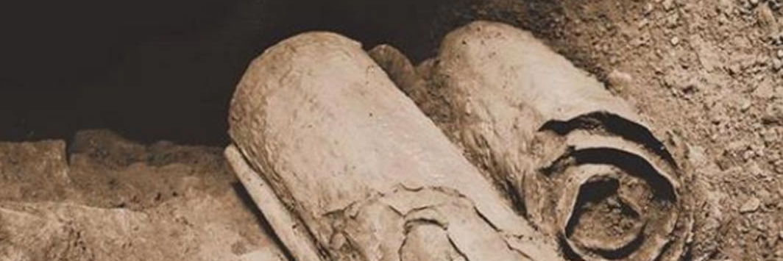
Jonathan Sherwood
Team Building activity

Slide 8
Mariano Sarabia with FBCO
Raising up Student leaders

Slide 9
Break Time!!

Slide 10
Phil Sherwood with Shiloh Ministries
Principles of Prayer

Slide 11
Jonathan Sherwood with RR
What a Season of Successful Serving looks like

Slide 12
Successful Servant Leadership
Elected
Equipping
Effecting
Edifying

