Slide 1

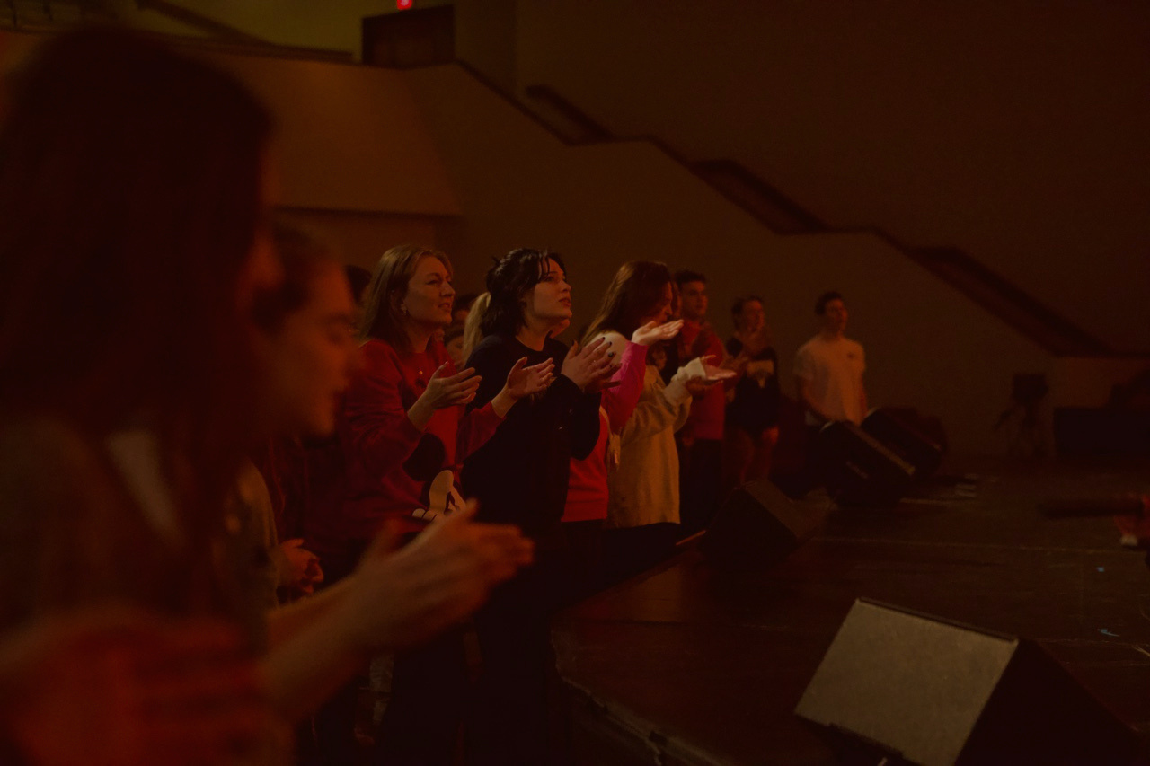


Raising Up
student leaders
@therealsarabia
Mariano.Sarabia@fbcofallon.org

Slide 2

Student Leadership = Student Discipleship

Slide 3
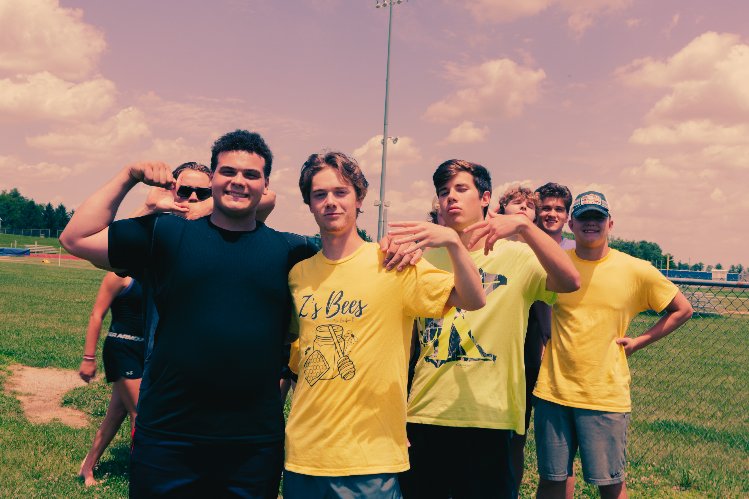
5 Steps of Discipleship:

Slide 4
5 Steps of Discipleship:
  Why do we do what we do?

Slide 5
5 Steps of Discipleship:
  Why do we do what we do?
2. Watch me.

Slide 6
5 Steps of Discipleship:
  Why do we do what we do?
2. Watch me.
3. Let’s do this together!

Slide 7
5 Steps of Discipleship:
  Why do we do what we do?
2. Watch me.
3. Let’s do this together!
4. Now you do it while I watch you.

Slide 8
5 Steps of Discipleship:
  Why do we do what we do?
2. Watch me.
3. Let’s do this together!
4. Now you do it while I watch you.
5. Go do it!

Slide 9

“Generation Z, encompassing individuals born between 1997 and 2012, exhibits a pronounced desire for purpose and empowerment. A study by the Harvard Graduate School of Education found that over half of young adults (58%) reported experiencing little or no purpose or meaning in their lives in the previous month.”
- Harvard Graduate School of Education

Slide 10

How to Start:

Slide 11
How to Start:
  Be long term > Short Term

Slide 12
How to Start:
  Be long term > Short Term
2. Unite under the Vision

Slide 13
How to Start:
  Be long term > Short Term
2. Unite under the Vision
3. Define your Leadership Team

Slide 14
How to Start:
  Be long term > Short Term
2. Unite under the Vision
3. Define your Leadership Team
4. Hold High Expectations

Slide 15
How to Start:
  Be long term > Short Term
2. Unite under the Vision
3. Define your Leadership Team
4. Hold High Expectations
5. Identify who is already serving

Slide 16
How to Start:
  Be long term > Short Term
2. Unite under the Vision
3. Define your Leadership Team
4. Hold High Expectations
5. Identify who is already serving
6. Elevate Leaders & Empower Students

Slide 17
How to Start:
  Be long term > Short Term
2. Unite under the Vision
3. Define your Leadership Team
4. Hold High Expectations
5. Identify who is already serving
6. Elevate Leaders & Empower Students
7. Make it Valuable

Slide 18

Tips & Advice
  Dream Big
2. Put the Fullness into writing
3. Have real roles in your ministry
4. Call Students Up -> In Sermons & Conversations
5. Identify & Empower Gifting
6. Building Genuine Relationships
7. Have Fun!

Slide 19
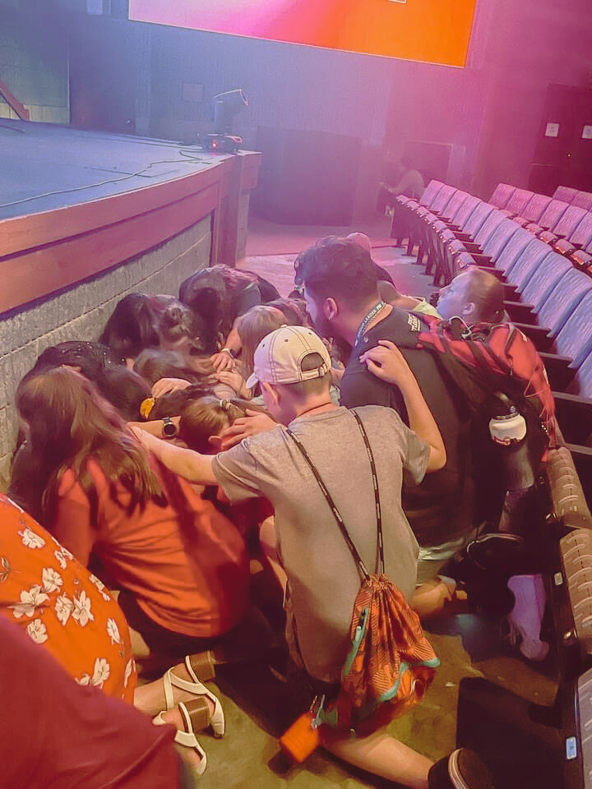
Challenge:
What are two strong areas for you and two weaknesses?

Slide 20
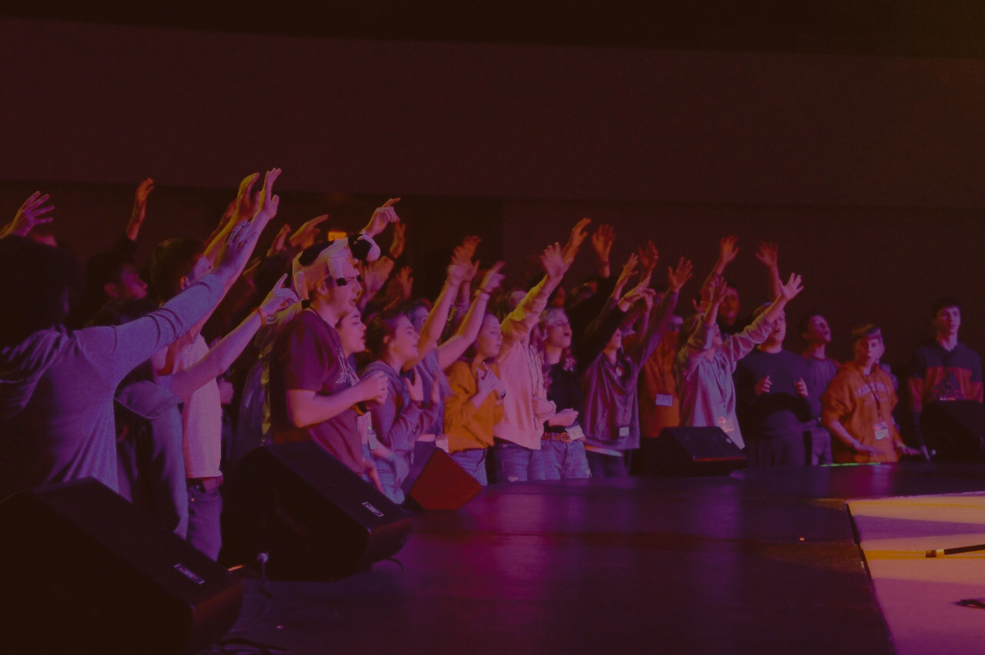
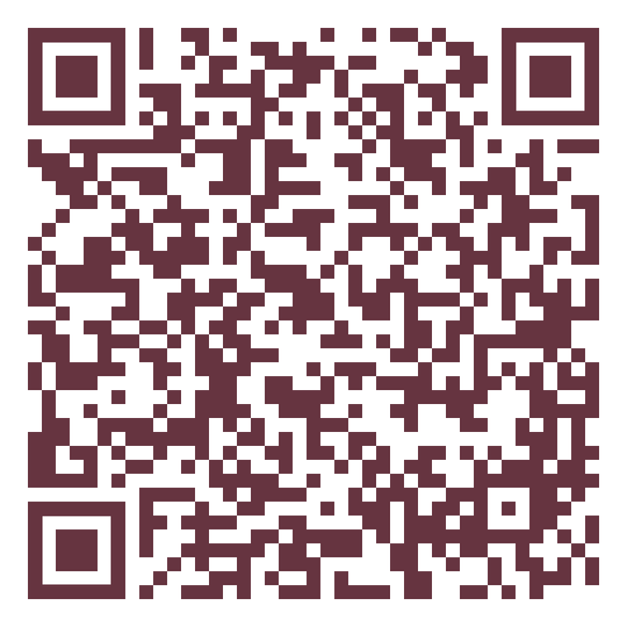
Resources:

Slide 21
Raising Up
student leaders
@therealsarabia
Mariano.Sarabia@fbcofallon.org

